Slide 1
Pattern formation in Escherichia coli: A model for the pole-to-pole oscillations of Min proteins and the localization of the division site
By CZERWINSKA Urszula,
DE BELLY Henry

Slide 2
INTRODUCTION
How does E. coli find its center ?

Slide 3
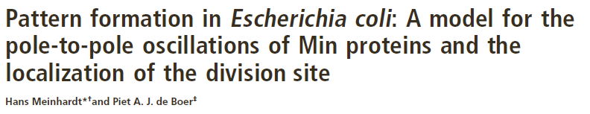
INTRODUCTION
How does E. coli find its center ?
MinD pole-to-pole oscillations !

Slide 4
Plan
Introduction of the model
Our results
Awesome movie
Project extansion

Slide 5
Part I: Introduction of the model

Slide 6
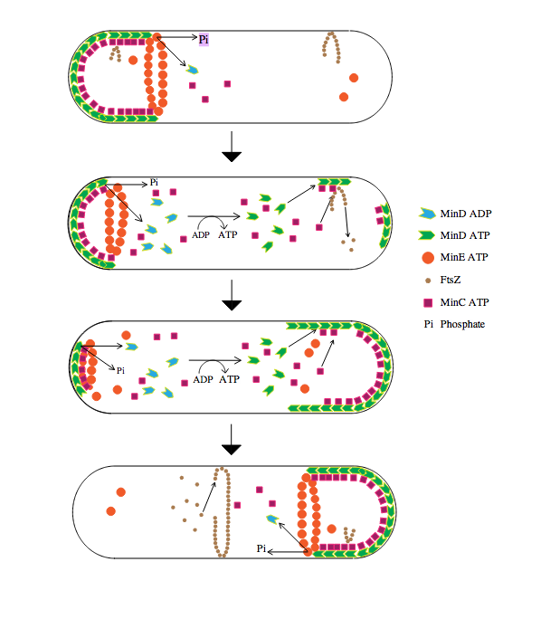
Introduction of the model
Some facts:
FtsZ define the position of division
MinD self assemble at the membrane
MinD recruit MinC that inhibits FtsZ
MinD also recruit MinE rings, that unbound MinD
The result of this system is a pole-to-pole oscillation of MinD/C

Slide 7
Introduction of the model
Some facts:
FtsZ define the position of division
MinD self assemble at the membrane
MinD recruit MinC that inhibits FtsZ
MinD also recruit MinE rings, that unbound MinD
The result of this system is a pole-to-pole oscillation of MinD/C

Slide 8
Introduction of the model
Some facts:
FtsZ define the position of division
MinD self assemble at the membrane
MinD recruit MinC that inhibits FtsZ
MinD also recruit MinE rings, that unbound MinD
The result of this system is a pole-to-pole oscillation of MinD/C

Slide 9
Introduction of the model
Some facts:
FtsZ define the position of division
MinD self assemble at the membrane
MinD recruit MinC that inhibits FtsZ
MinD also recruit MinE rings, that unbound MinD
The result of this system is a pole-to-pole oscillation of MinD/C

Slide 10
Introduction of the model
Bound
Precursors (unbound)

Slide 11
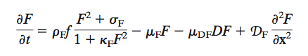
Introduction of the model
Precursors (unbound)
Bound

Slide 12
Introduction of the model
Precursors (unbound)
Bound
Production

Slide 13
Introduction of the model
Precursors (unbound)
Bound
Production
Synergy

Slide 14
Introduction of the model
Precursors (unbound)
Bound
Production
Synergy
Degradation

Slide 15
Introduction of the model
Precursors (unbound)
Bound
Production
Synergy
Degradation
Degradation
MinD mediated

Slide 16
Introduction of the model
Precursors (unbound)
Bound
Production
Synergy
Degradation
Degradation
MinD mediated
Diffusion

Slide 17
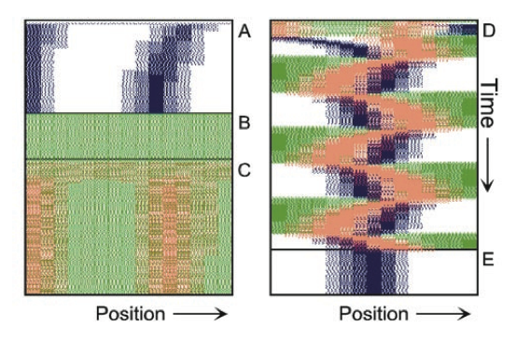
Main result of the paper
MinD/C = Green
MinE = Red
FtsZ= Black
Figure 1: Complete model running for x=15 E: FtsZ Ring remains in place after switching off MinE/e and MinD/d.

Slide 18
Part II : Our results

Slide 19
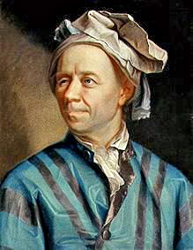
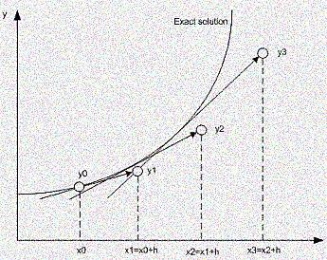
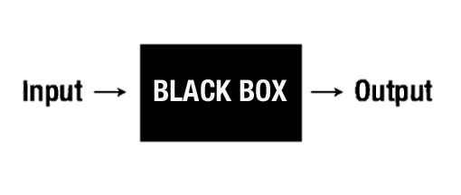
Model implementation in MATLAB
Euler method for ODE
ODE solver
Notes:
http://www.youtube.com/watch?v=RGtCw5E7gBc
=> board ?

Slide 20
Model implementation in MATLAB
Euler method for ODE
E.coli divided in space units
0.15 µm
3 µm = 20 space units
Notes:
http://www.youtube.com/watch?v=RGtCw5E7gBc
=> board ?

Slide 21
Model implementation in MATLAB
Euler method for ODE
E.coli divided in space units
Diffusion
0.15 µm
X -1
X +1
x
3 µm = 20 space units
$$D\left(x\right)=coeffD ×(C\left(x−1\right)+C\left(x+1\right)−2C\left(x\right))$$
Notes:
http://www.youtube.com/watch?v=RGtCw5E7gBc
=> board ?

Slide 22
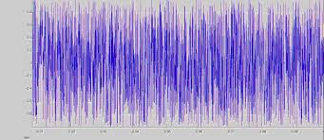
Model implementation in MATLAB
Euler method for ODE
E.coli divided in space units
Diffusion
Noise
0.15 µm
3 µm = 20 space units
Notes:
http://www.youtube.com/watch?v=RGtCw5E7gBc
=> board ?

Slide 23
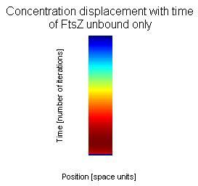
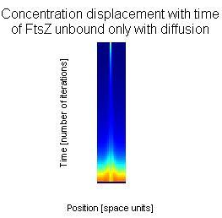
Our results
First results
Notes:
http://www.youtube.com/watch?v=RGtCw5E7gBc
board ?
Talk abut noise

Slide 24
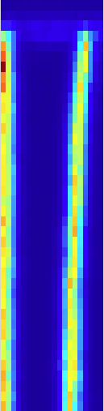
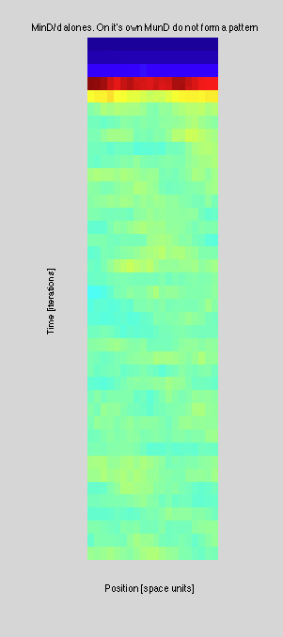
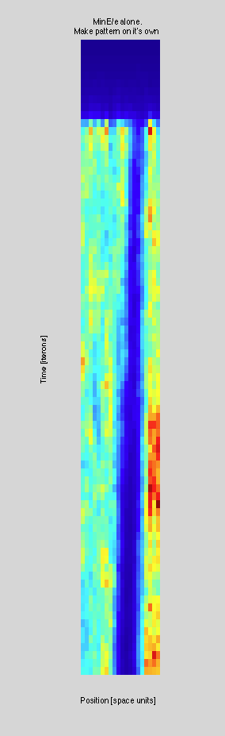
Our results
Components of the center finding systems in E.Coli MinD,
Min E and FtsZ alone
time [number of iterations]
A
B
C
FtsZ alone
MinD precursor on
MinE

Slide 25
Our results
Components of the center finding systems in E.Coli MinD,
Min E and FtsZ alone
time [number of iterations]
A
B
C
FtsZ alone
MinD precursor on
MinE

Slide 26
Our results
Components of the center finding systems in E.Coli MinD,
Min E and FtsZ alone
time [number of iterations]
A
B
C
FtsZ alone
MinD precursor on
MinE

Slide 27
Our results
Components of the center finding systems in E.Coli MinD,
Min E and FtsZ alone
time [number of iterations]
A
B
C
FtsZ alone
MinD precursor on
MinE

Slide 28
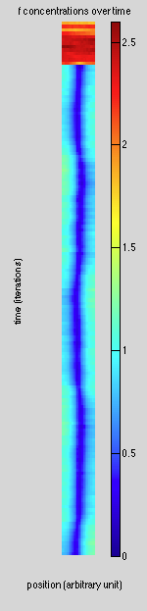
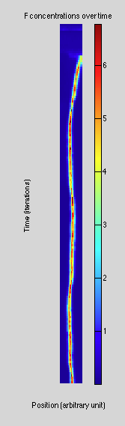
Our results
FtsZ
F
f
time [number of iterations]
position [space units]
All components of the complete system, represented one by one.
Notes:
Duplicate and make the figure appear two by two maybe

Slide 29
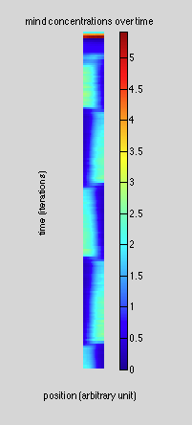
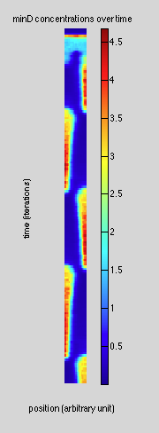
Our results
FtsZ
F
f
Mind
MinD
time [number of iterations]
position [space units]
All components of the complete system, represented one by one.
Notes:
Duplicate and make the figure appear two by two maybe

Slide 30
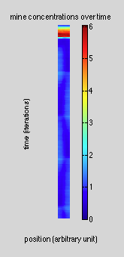
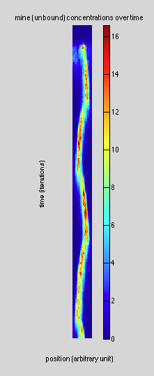
Our results
FtsZ
F
MinE
f
Mind
MinD
Mine
time [number of iterations]
position [space units]
All components of the complete system, represented one by one.
Notes:
Duplicate and make the figure appear two by two maybe

Slide 31
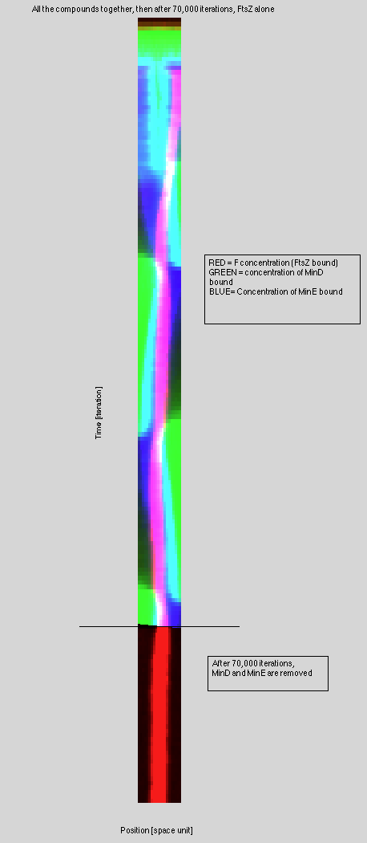
Our results
All system’s components together
FtsZ (red), MinD (green), MinE (blue)
time [number of iterations]
After switching off of MinD
position [space units]

Slide 32
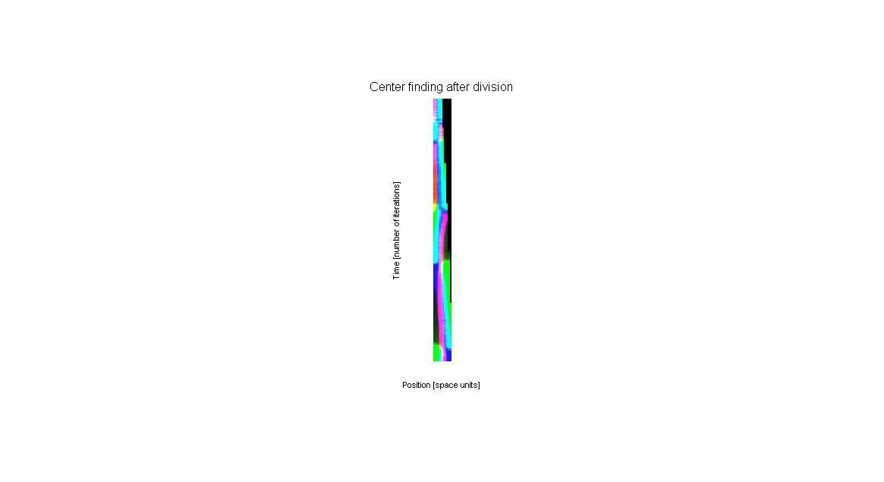
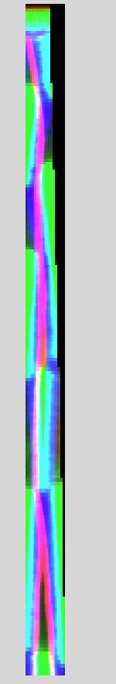
Our results
E.Coli after division
E.Coli excessively growing
10
20
time [number of iterations]
time [number of iterations]
20
position [space units]
32

Slide 33
Part III: MOVIE !

Slide 34
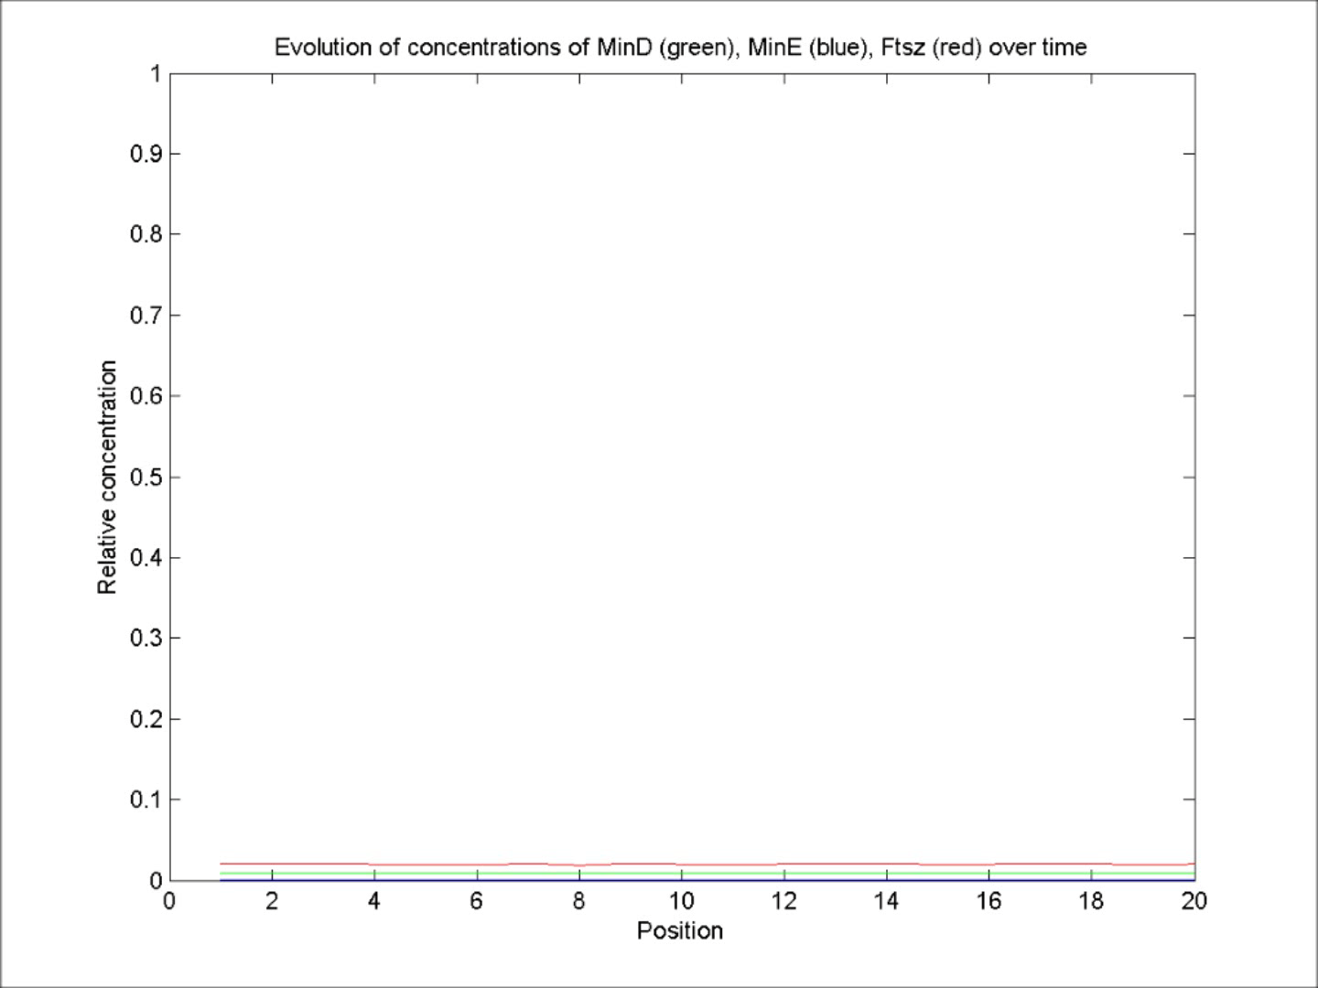
Awesome Movie
Our results
Produced by Timo
Directed by Ula & Henry
Actors: MinD/MinE/FtsZ
Scenarist: E. coli

Slide 35
Part IV: Extension of the model

Slide 36
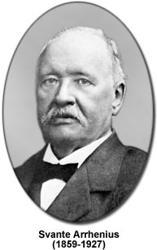
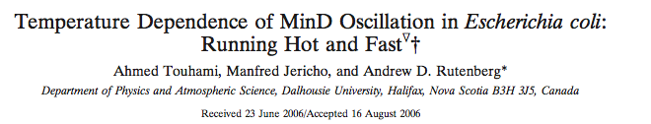
Project extension ideas

Slide 37
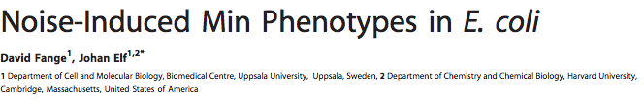
Project extension ideas

Slide 38
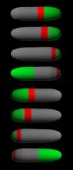
Project extension ideas

Slide 39
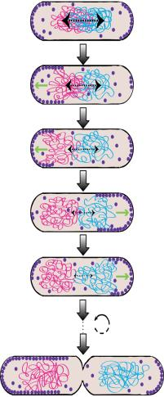
Project extension ideas

Slide 40
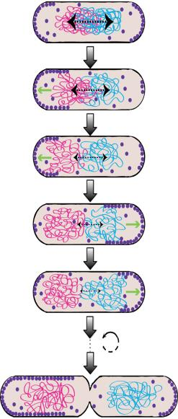
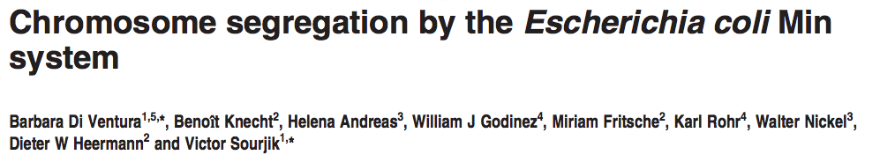
Chromosome segregation
Published: 10/09/13
- The existence and nature of an active chromosome segregation apparatus in bacteria has been a long-standing debate.

Slide 41
Chromosome segregation
Published: 10/09/13
- The existence and nature of an active chromosome segregation apparatus in bacteria has been a long-standing debate.
- Numerical simulations show that entropy alone is not sufficient to complete segregation of bacterial chromosomes.

Slide 42
Chromosome segregation
Published: 10/09/13
- The existence and nature of an active chromosome segregation apparatus in bacteria has been a long-standing debate.
- Numerical simulations show that entropy alone is not sufficient to complete segregation of bacterial chromosomes.
-Experimental evidence show that MinD oscillations seems to pull the chromosomes

Slide 43
Chromosome segregation
Published: 10/09/13
- The existence and nature of an active chromosome segregation apparatus in bacteria has been a long-standing debate.
- Numerical simulations show that entropy alone is not sufficient to complete segregation of bacterial chromosomes.
-Experimental evidence show that MinD oscillations seems to pull the chromosomes
Our Goal: Integrate DNA segregation by the MinD system in our model.

Slide 44
Chromosome segregation
Methods

Slide 45
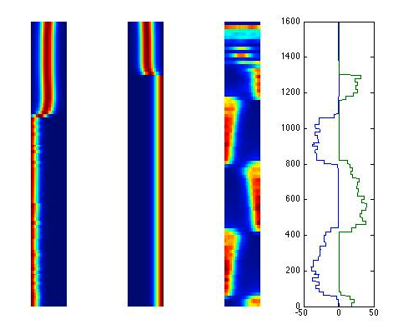
Chromosome segregation
Chromosome 1
Chromosome 2
MinD
Pulling force exerted by MinD on the DNA
Time REVSERED [number of iterations]
time [number of iterations]
time [number of iterations]
time [number of iterations]
position [space units]

Slide 46
Chromosome segregation
Chromosome 1
Chromosome 2
MinD
Pulling force exerted by MinD on the DNA
Time[number of iterations]
time [number of iterations]
time [number of iterations]
time [number of iterations]
position [space units]

Slide 47
CONCLUSION
How does E.coli find its center ?
E.coli proteins MinD/C, MinE and FtsZ dynamics can be modeled

Slide 48
CONCLUSION
How does E.coli find its center ?
E.coli proteins MinD/C, MinE and FtsZ dynamics can be modeled
The model is robust and reproductible

Slide 49
CONCLUSION
How does E.coli find its center ?
E.coli proteins MinD/C, MinE and FtsZ dynamics can be modeled
The model is robust and reproductible
Severals improvments of the model can still be done (detailled steps, precision/variation of some parameters, spatial diffusion…)

Slide 50
CONCLUSION
How does E.coli find its center ?
E.coli proteins MinD/C, MinE and FtsZ dynamics can be modeled
The model is robust and reproductible
Severals improvments of the model can still be done (detailled steps, precision/variation of some parameters, spatial diffusion…)
MinD Oscillations can be used to perform chromosomes segregations during the division

Slide 51
HAPPY END
Thank you for your attention!
Note: this project couldn’t be accomplished (or even really started) without Timo’s help. Thank you Timo!

